Slide 1

DATA MINING PROJECT
Group 2
Section - 01

Slide 2





Team members
Vetrivel Ramalingam
Rakshit Gade
Asmita Singh
Karthikeya Reddy Vanguru
Manish Kumar Thondepu

Slide 3

AGENDA
MOTIVATION
HYPOTHESIS
PROCESS OVERVIEW
FEATURE ANALYSIS
PRE-PROCESSING
MODELS
MODEL COMPARISON

Slide 4
Motivation
In the ever-evolving landscape of e-commerce, understanding the factors that contribute to a product's popularity is crucial for businesses seeking to optimize their offerings. Our motivation stems from the realization that behind each transaction lies a wealth of insights waiting to be discovered.
Why Focus on Popularity?
Strategic Decision-Making: Identify trends and patterns to guide business strategies and inventory management.
Increase in revenue: Tailor the online shopping experience by highlighting popular products for customer satisfaction to increase chances of selling more

Slide 5
hypothesis
H0: The popularity of a product is dependent on number of times the product was sold, type of product, and cost of the product
H1: The popularity of a product is not dependent on number of times the product was sold, type of product, and cost of the product

Slide 6
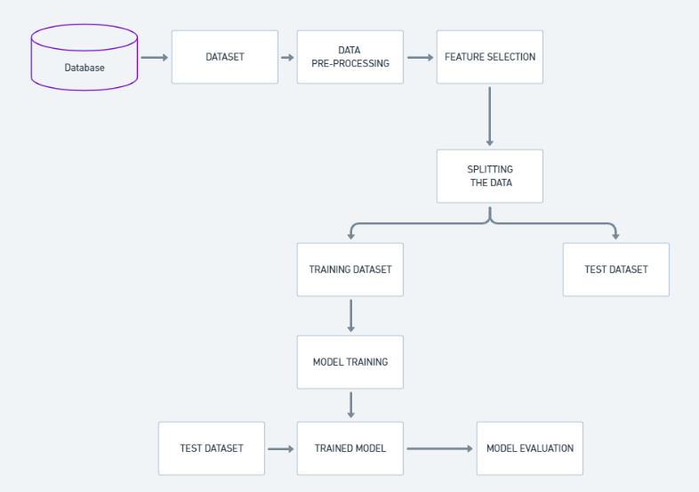
Process overview
Models Used:
Naïve Bayes
Neural Networks
Logistic Regression
Market Basket Analysis
Random Forest
Decision Tree
Time Series Analysis

Slide 7
DATASET
The dataset comprises 128,976 records of fashion apparel product orders sourced from Amazon. These orders span from March 2022 to June 2022, encapsulating a comprehensive snapshot of transactional activity during this period. Some features that we have utilized are:
Style
SKU
Quantity

Slide 8
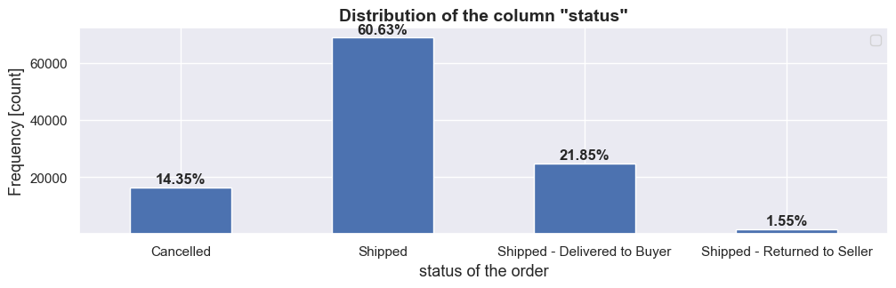
Feature analysis
Feature 'status' exhibits significant class imbalance, with the majority of orders being "Shipped" (60.63%). Classes such as "Cancelled" (14.35%) and various low-frequency statuses, including some related to shipping issues, highlight potential challenges for accurate prediction.

Slide 9
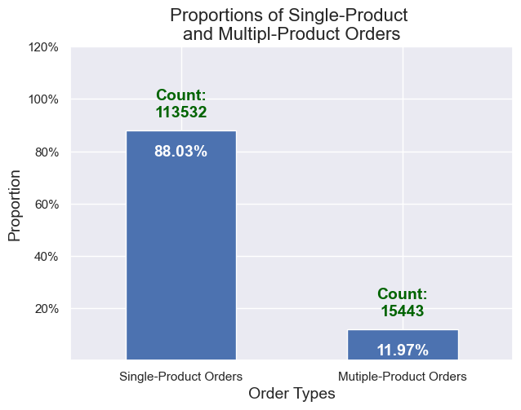
Feature analysis
We see that 88.03% (almost 90%)of the data are from orders with single-product order.
We are now interested in the majority and, therefore, drop the multiple-product orders.
And, we focus our analysis on the single-product orders for prediction/classification.

Slide 10
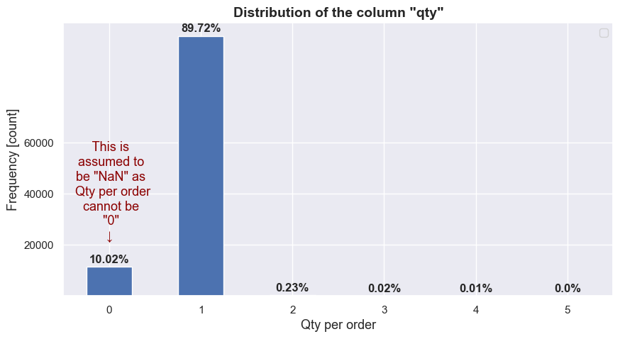
Feature analysis
Feature "qty" is highly skewed (when assuming it as *continuous variable*), or
It's highly imbalanced (when assuming it as *categorical variable*)
It's logical to assume the value "0" as "NaN" (Null) because an order purchased cannot have quantity "0"
More than 99% of datapoints have value "1" or "NaN" so it may not add much information in the analysis.

Slide 11
Pre-processing of dataset
Dropped all features except for OrderID, Date, Style, SKU, Quantity & Status
Removed rows where Status was ‘Cancelled’
Dropped rows with ‘NULL’ values
Discarded duplicate records

Slide 12
RANDOM FOREST CLASSIFICATION
Aggregating SKUs for Each Order ID
Encoding Style & SKU values
Split the data into training and test set
Model Training
Evaluating the model

Slide 13
NAÏVE BAYES
Aggregate Data
Determine Popularity Threshold
Create Binary Target Variable
Encode Categorical Columns
Define Features and Target
Split Dataset
Initialize and Train Naive Bayes Classifier
Evaluate the Model

Slide 14
MARKET BASKET ANALYSIS
Identify & select relevant columns
Aggregating SKUs for Each Order ID
Encoding SKU Values
Model Training
Rule Generation with Minimum Threshold

Slide 15
NEURAL NETWORK
Define Popularity Column: Threshold = 0.7
Select Features and Target
One-Hot Encoding for Categorical Features: Style & SKU
Split Data into Train and Test: 70% & 30%
Scale Features: Standardize feature values using the Standard Scaler to ensure consistent input for the neural network.

Slide 16
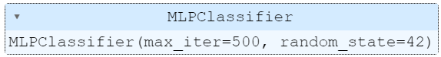
NAÏVE BAYES
Train Neural Network Model (MLPClassifier):Employ the Multi-layer Perceptron (MLP) Classifier with specified parameters:-
`hidden_layer_sizes=(100,)`: One hidden layer with 100 neurons.
`max_iter=500`: Maximum number of iterations during optimization.
`random_state=42`: A seed for reproducibility, ensuring consistent results.
Predict and Evaluate

Slide 17
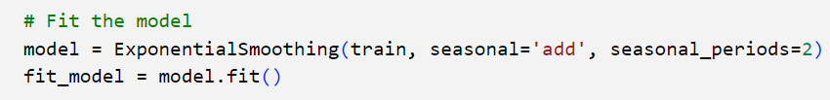
Time series analysis
Converting the Date column to datetime format and setting it as index
Aggregating the amount by date
Splits the data into training (before June 2022) and testing (after June 2022) sets
Initializes and fits an Exponential Smoothing model (Holt-Winters) to the training data
Forecasts future values for a specified number of periods (30 days in this case)
Plots the historical sales, actual sales for June (test set), and predicted sales for June

Slide 18
Decision tree
Aggregate the data to find the number of products per SKU
Calculate the threshold for popularity
Create the binary target variable
One-Hot encoding for categorical features
Split the dataset into train & test
Fit the decision tree model
Evaluate the model and plot the tree

Slide 19
LOGISTIC Regression
Define Popularity Column
Select Features and Target
One-Hot Encoding for Categorical Features
Split Data
Create and Train Logistic Regression Model
Predict and Evaluate

Slide 20
Model comparison
MODEL | ACCURACY | PRECISION (0) | PRECISION(1)
Logistic Regression | 0.56 | 0.13 | 0.9
Naïve Bayes | 0.88 | 0.17 | 0.89
Neural Network | 0.88 | 0.66 | 0.89
Random Forest | 0.99 | 1 | 1
Decision Tree | 0.99 | 1 | 1

Slide 21

Thank You

